Slide 1

Struktur Data
Graphs
Prepared by
Frans Panduwinata, S.Kom, M.T

Slide 2
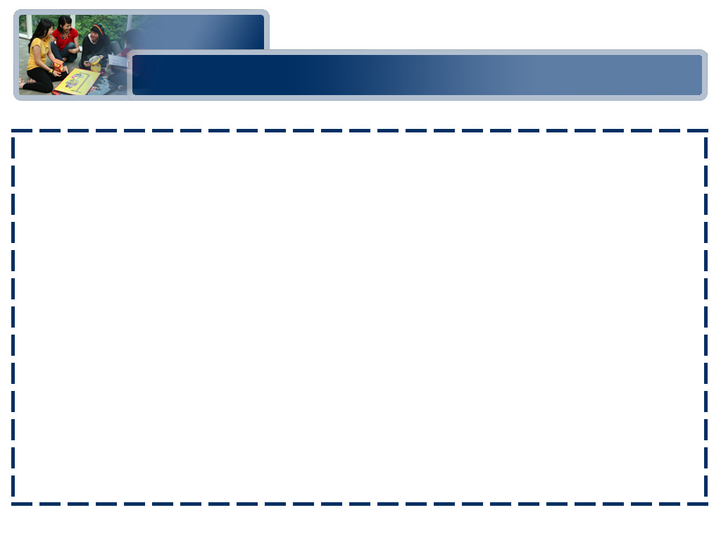
Definition
Graph
A data structure that consists of a set of nodes and a set of edges that relate the nodes to one another.
Vertex
A node in a graph.
Edge (arc)
A pair of vertices representing a connection between two nodes in a graph.

Slide 3
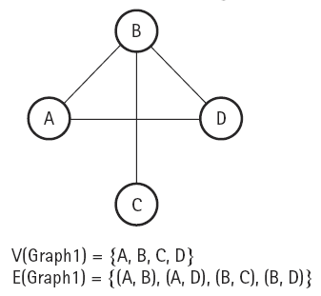
Undirected Graph
Undirected graph
A graph in which the edges have no direction.

Slide 4
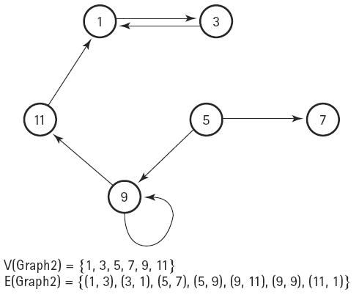
Directed Graph
Directed graph (digraph)
A graph in which each edge is directed from one vertex to another (or the same) vertex.

Slide 5
Definition
Adjacent vertices
Two vertices in a graph that are connected by an edge.
Path
A sequence of vertices that connects two nodes in a graph.
Complete graph
A graph in which every vertex is directly connected to every other vertex.
Weighted graph
A graph in which each edge carries a value.

Slide 6
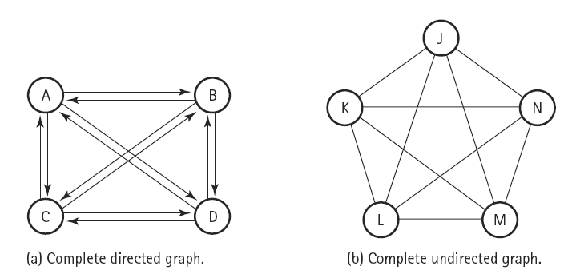
Complete Graph
EXAMPLE:

Slide 7
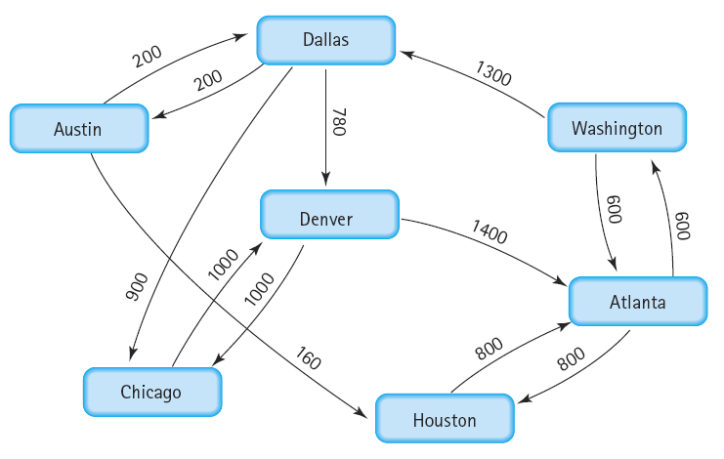
Weighted Graph
EXAMPLE:

Slide 8
Depth-First Traversal
When a graph is traversed by visiting the nodes in the forward (deeper) direction as long as possible, the traversal is called depth-first traversal.
From previous example, suppose we want to fly from Austin to Washington.

Slide 9
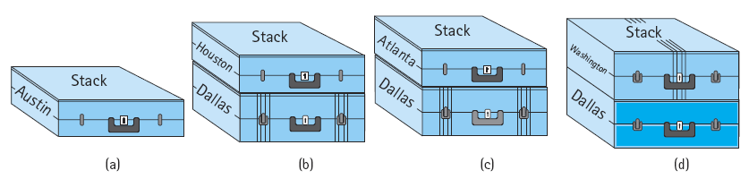
Depth-First Traversal (cont)
EXAMPLE:
  At the beginning of the loop, we pop the current city, Austin, from the stack.
  The places we can reach directly from Austin are Dallas and Houston, we push these vertices onto the stack.
  At the beginning of the second iteration, we pop the top vertex from the stack--Houston.
  Houston is not our destination, so we resume our search from there.

Slide 10
Depth-First Traversal (cont)
EXAMPLE: (cont)
  There is only one flight out of Houston, to Atlanta; we push Atlanta onto the stack.
  Again we pop the top vertex from the stack.
  Atlanta is not our destination, so we continue searching from there, Atlanta has flights to two cities: Houston and Washington.
  But we just came from Houston! This coud cause an infinite loop.

Slide 11
Depth-First Traversal (cont)
EXAMPLE: (cont)
  That is, we must mark a city as having been visited so that it is not investigated a second time. Houston has already been visited, so we ignore it.
  The second adjacent vertex, Washington, has not been visited so we push it onto the stack. Again we pop the top vertex from the stack.
  Washington is our destination so the search is complete.

Slide 12
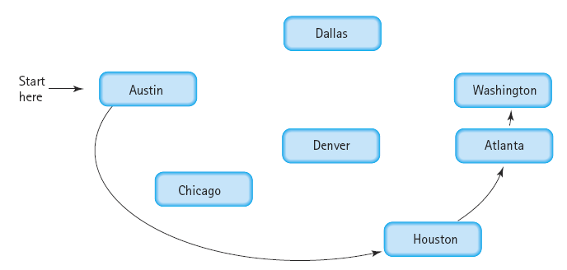
Depth-First Traversal (cont)
This search is called
a depth-first search
because
we go to the deepest branch, examining all paths beginning at Houston before we come back to search from Dallas.
When you have to backtrack, you take the branch closest to where you dead-ended.
That is, you go as far as you can down one path before you take alternative choices at earlier branches.

Slide 13
Breadth-First Traversal
A breadth-first search
  looks at all possible paths at the same depth before it goes to a deeper level.
  checks all possible one-stop connections before checking any two-stop connections.

Slide 14
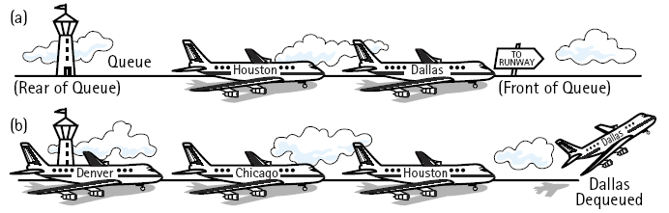
Breadth-First Traversal (cont)
EXAMPLE:
  First, we enqueue all cities that can be reached directly from Austin: Dallas and Houston. Then we dequeue the front queue element.
  Dallas in not the destination we seek, so we enqueue all adjacent cities that have not yet been visited: Chicago and Denver. (Austin has been visited already, so it is not enqueued).

Slide 15

Breadth-First Traversal (cont)
EXAMPLE: (cont)
  Again we dequeue the front element from the queue.
  This element is the other "one-stop" city, Houston.
  Houston is not the desired destination, so we continue the search.
  Only one flight goes out of Houston, to Atlanta.
  Because we haven't visited Atlanta before, it is enqueued.

Slide 16

Breadth-First Traversal (cont)
EXAMPLE: (cont)
  Now we know that we cannot reach Washington with one stop, so we start examining the two-stop connections.
  We dequeue Chicago; this is not our destination, so we put its adjacent city, Denver, into the queue.
  Now an interesting situation arises: Denver is in the queue twice.

Slide 17
Breadth-First Traversal (cont)
Should we mark a city as having been visited when we put it in the queue or after it has been dequeued, when we are examining its outgoing flights?
  If we mark it only after it is dequeued, the queue may include multiple copies of the same vertex (so we need to check whether a city is marked after it is dequeued).
  An alternative approach is to mark the city as having been visited before it is put into the queue. Which technique is better?
  It depends on the processing. You may want to know whether alternative routes exist, in which case you would want to put a city into the queue more than once.

Slide 18

Breadth-First Traversal (cont)
EXAMPLE: (cont)
  We have put Denver into the queue in one step and removed its previous entry at the next step.
  Denver is not our destination, so we put its adjacent cities that we haven't already marked (only Atlanta) into the queue.
  This processing continues until Washington is put into the queue (from Atlanta) and finally dequeued.

Slide 19
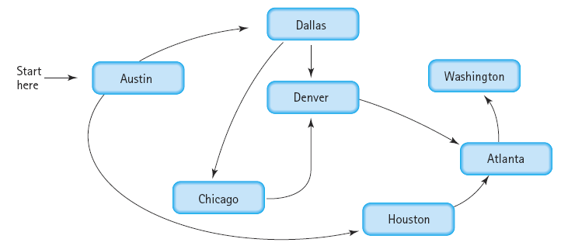
Breadth-First Traversal (cont)
We have found the desired city, and the search is complete.

Slide 20
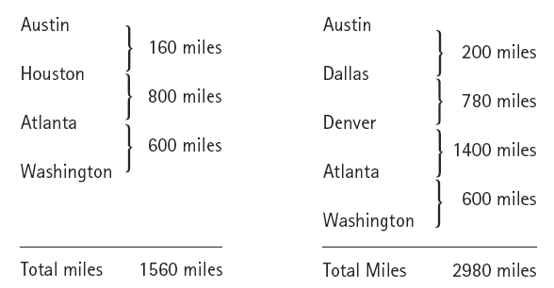
The Single-Source Shortest-Path Problem
Single-Source Shortest-Path or Minimum-Cost Spanning Tree means the path whose edge values (weights), when added together, have the smallest sum.
Consider the following two paths from Austin to Washington:

Slide 21
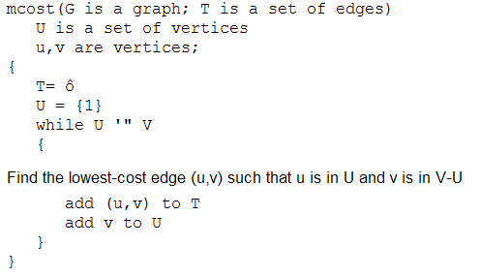
Prim's Algorithm
Let G = (V,E) be a weighted graph, and suppose V = {1,2,…,n}.
The Prim's algorithm begins with a set U initialized to {1}, and at each stage finds the shortest edge (u,v) that connects u in U and v in V-U, and then adds v to U.
It repeats this step until
U = V.

Slide 22
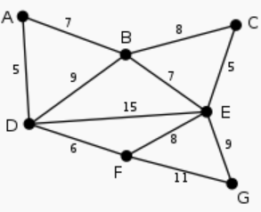
Prim's Algorithm (cont)
EXAMPLE:

Slide 23
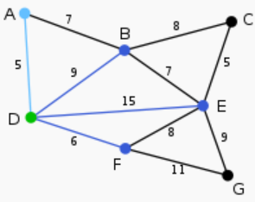

Prim's Algorithm (cont)
EXAMPLE: (cont)

Slide 24
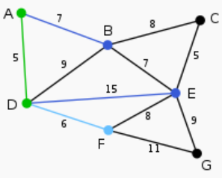

Prim's Algorithm (cont)
EXAMPLE: (cont)

Slide 25
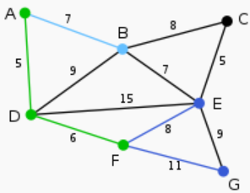
Prim's Algorithm (cont)
EXAMPLE: (cont)

Slide 26
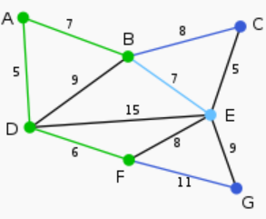
Prim's Algorithm (cont)
EXAMPLE: (cont)

Slide 27
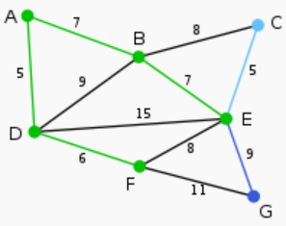
Prim's Algorithm (cont)
EXAMPLE: (cont)

Slide 28
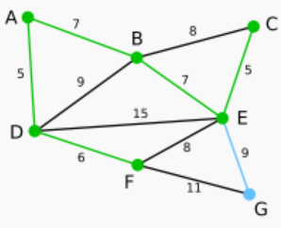
Prim's Algorithm (cont)
EXAMPLE: (cont)

Slide 29
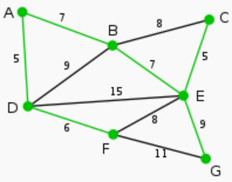
Prim's Algorithm (cont)
EXAMPLE: (cont)

Slide 30
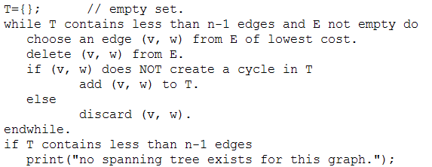
Kruskal's Algorithm
The Algorithm:

Slide 31
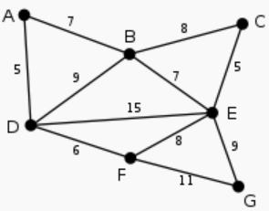
Kruskal's Algorithm (cont)
EXAMPLE:

Slide 32
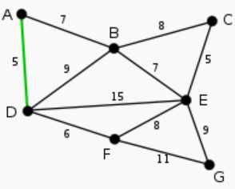
Kruskal's Algorithm (cont)
EXAMPLE: (cont)

Slide 33
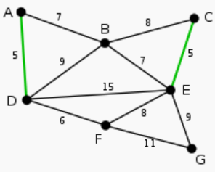
Kruskal's Algorithm (cont)
EXAMPLE: (cont)

Slide 34
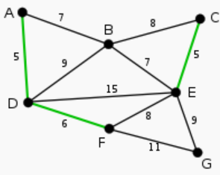
Kruskal's Algorithm (cont)
EXAMPLE: (cont)

Slide 35
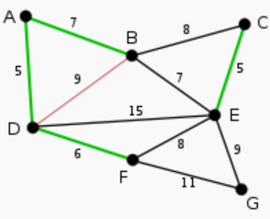

Kruskal's Algorithm (cont)
EXAMPLE: (cont)

Slide 36
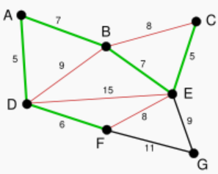

Kruskal's Algorithm (cont)
EXAMPLE: (cont)

Slide 37
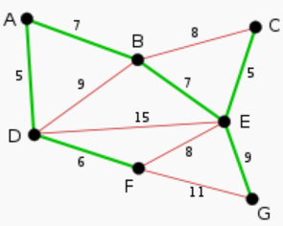
Kruskal's Algorithm (cont)
EXAMPLE: (cont)

Slide 38
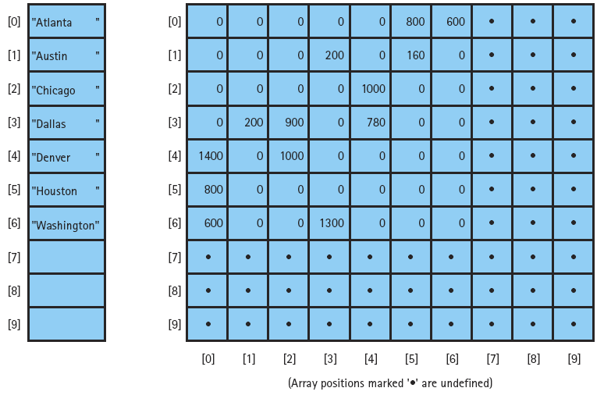
Array-Based Implementation

Slide 39
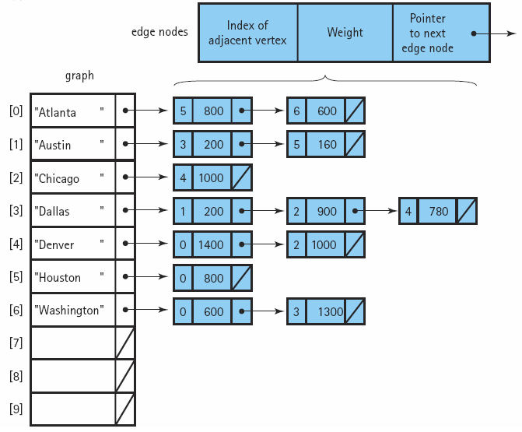
Linked Implementation

